Slide 1
Hunting Right Career Path
Prepared By:
Kailash
Guided By:
Manvi Mehta

Slide 2
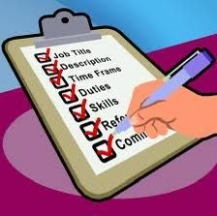
Contents
Why IT field ?
Why Manual Testing Course ?
Job Description
Skills Required

Slide 3

Why “it” field ?
The IT field challenges individuals to continually grow and adapt, fostering personal development and skill enhancement.
IT skills are valued worldwide, offering opportunities for international work or collaboration.
IT roles often involve problem-solving and creativity, allowing for innovation and new solutions.

Slide 4

This field offers too many opportunities for growth innovation and impact.
Continuous Evolution
Problem-solving Culture
Competitive Salaries
Remote Work
Cybersecurity Challenges
Multiple Career options
Environmental Sustainability
Education Technology

Slide 5
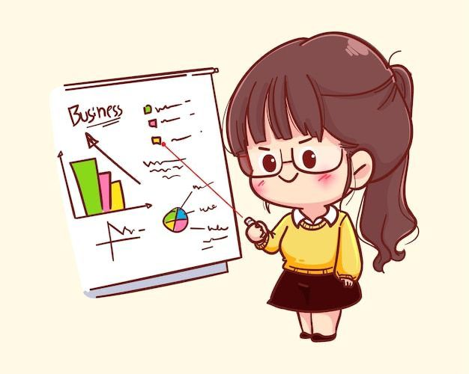
Scope in IT field :
Quality Assurance and Testing
Software Development
Mobile Technologies
Cybersecurity:
Artificial Intelligence

Slide 6
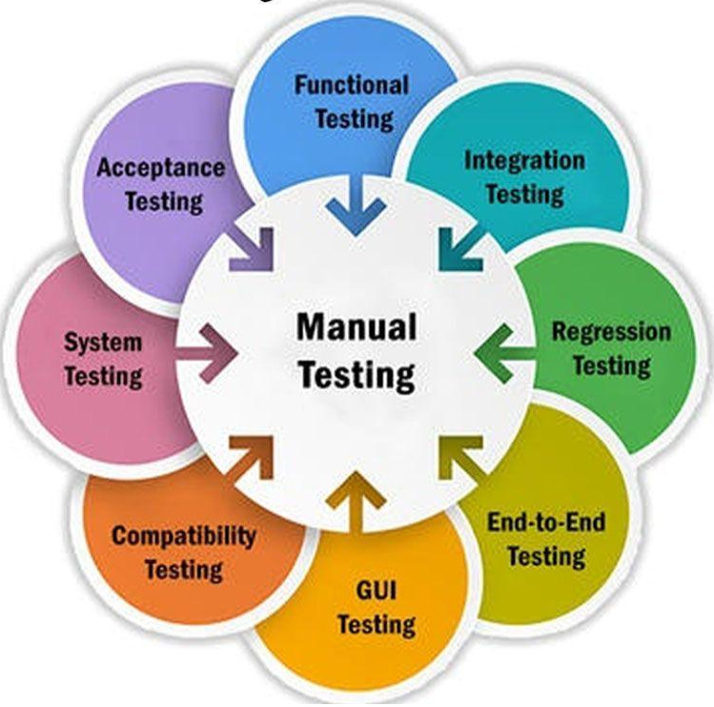
Why Manual Testing Course ?
Manual testing plays a crucial role in ensuring the quality and reliability of software products by identifying defects, bugs, and inconsistencies that may affect user experience.
Manual testing is often more cost-effective for smaller projects or projects with frequently changing requirement

Slide 7

Choosing a manual testing course can be beneficial for several reasons:
Foundational Knowledge
Practical Experience
Entry Level Opportunities
Complement to Automation
Flexibility and Adaptability
Real User Experience
Better Understanding of Customer Needs

Slide 8
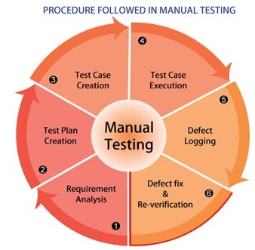
Job Description

Slide 9

Tester Duties and Responsibilities :
Test Planning
Test Case Design
Test Execution
Defect Reporting
Regression Testing
Test Documentation
Risk Assessment

Slide 10
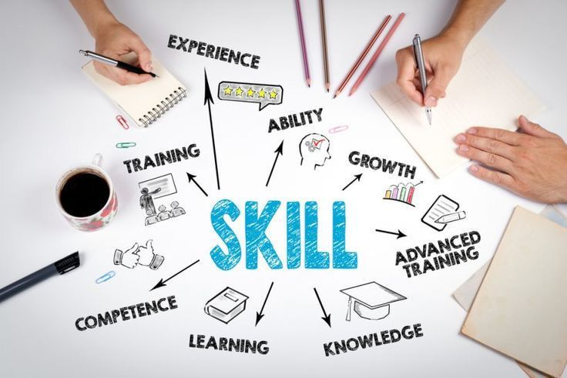
Skills Required
Problem-Solving Skill
Test Planning and Design Skill
Adaptability Skill
Regression Testing Skill
Documentation Skill
Performance Testing Skill
Analytical Skill
Communication Skill

Slide 11

Question
Who came first ?
A tester
A Bug

Slide 12
Thank You

